Slide 1
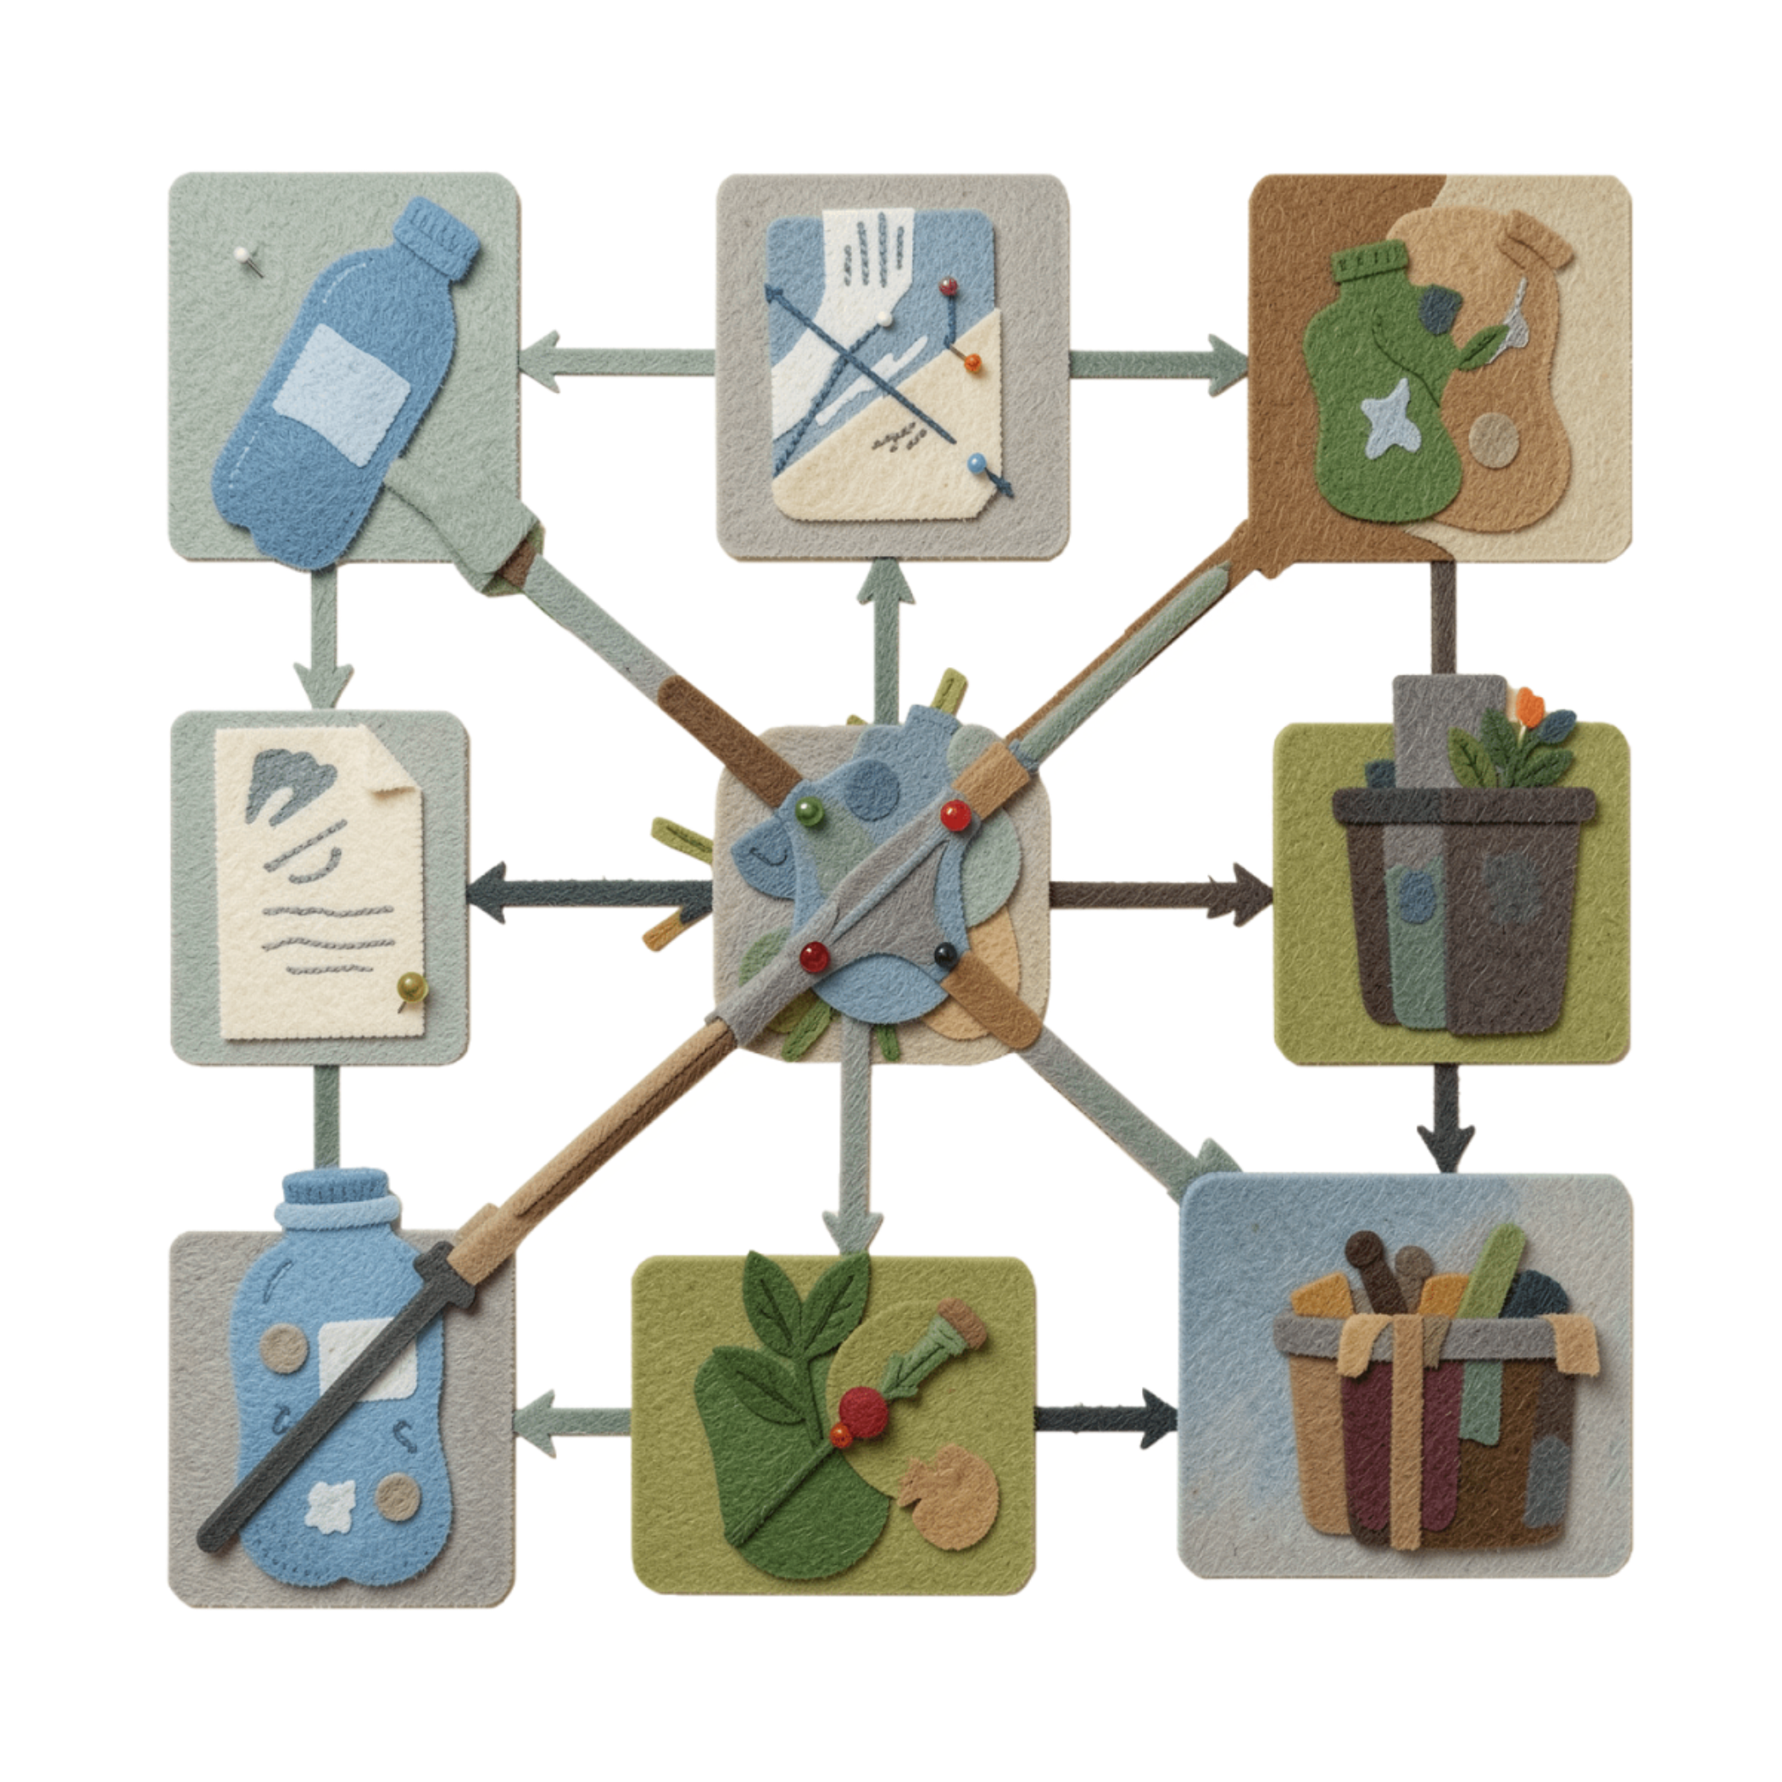
Garbage Classification Using Deep Learning
Hasibur Rahman Sun — 0112330199
Nafis Iqbal Neloy — 0112330617
Md. Mishkatul Bary — 0112330669
Abdullah Al Muhaimin — 0112330641
Farjana Akter — 0112330657
Jannatul Ferdaous — 0112330670
1

Slide 2
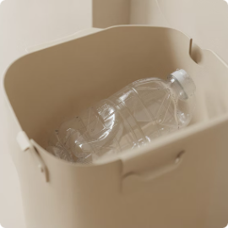

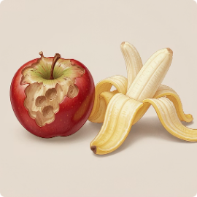
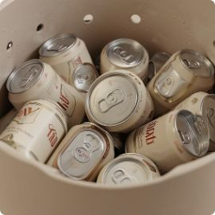


Background & Problem Statement
Background
Waste segregation is a critical component of effective waste management. Different waste materials require appropriate identification and separation, which is often a manual, labor-intensive process. Image-based classification presents a promising opportunity to automate a significant portion of this essential task.
Plastic
Paper
Problem Statement
Manual waste classification is inherently inefficient and inconsistent. Furthermore, real-world garbage images exhibit considerable variations in orientation, lighting, background, and appearance. Consequently, developing a reliable automatic classification system poses a challenging computer-vision problem.
Organic
Metal
Our focus is on:
How effectively can deep-learning models classify garbage images into predefined categories?
Glass
Textile
2

Slide 3

Project Objectives
Main Objective
To develop and evaluate a deep-learning-based image classification system for identifying different categories of garbage.
Clear Goal
Specific Objectives
Deployment Plan
Dataset Quality
Analyze and prepare the garbage image dataset.
Develop a consistent preprocessing and augmentation pipeline.
Apply transfer learning using pretrained EfficientNet architectures.
Develop a Custom CNN as an experimental baseline.
Compare candidate models using standard classification metrics.
Identify the most suitable model based on experimental performance.
Model Accuracy
Clearly defined objectives guide our research and evaluation.
3

Slide 4
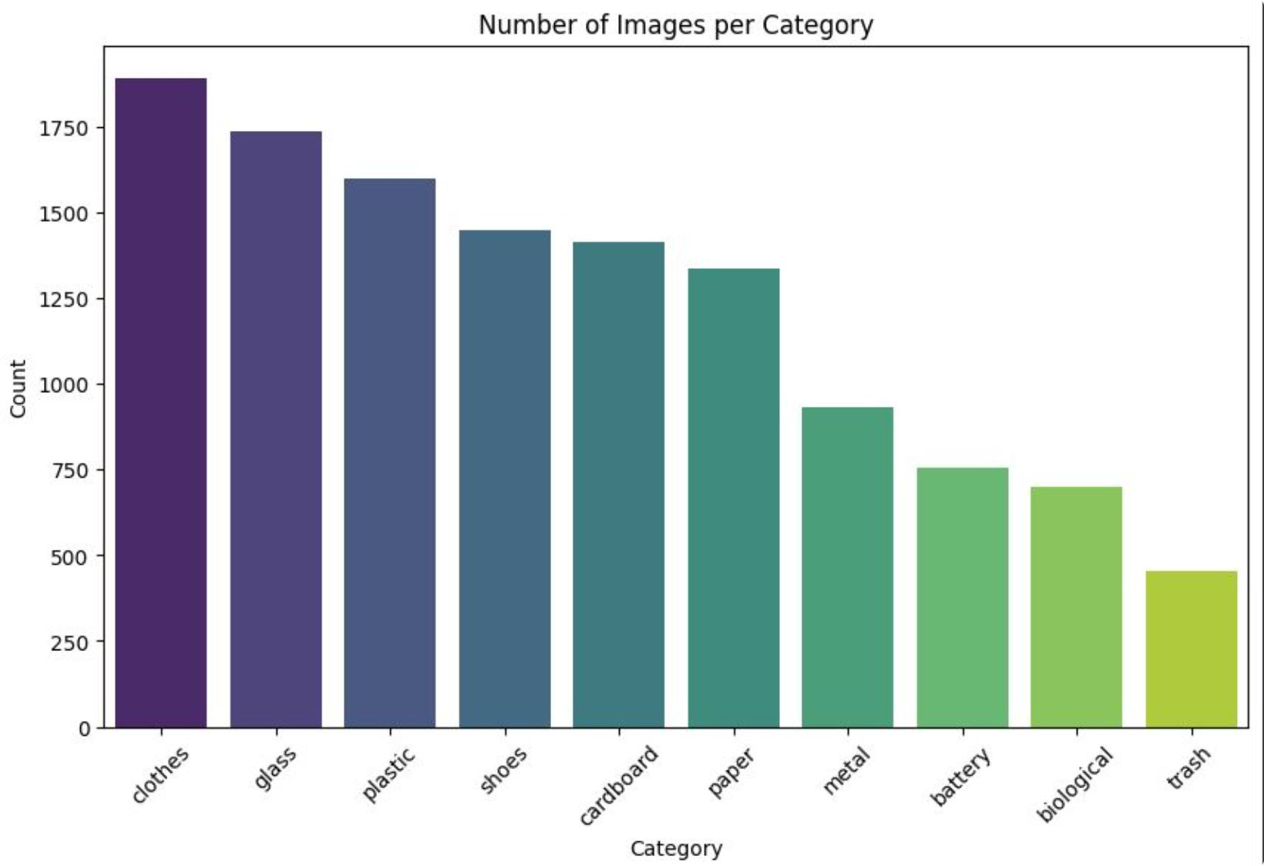
Dataset and Exploratory Analysis
Dataset: Garbage Classification V2 (Kaggle). (Dataset source citation placed in report.)
Class taxonomy: 10 garbage categories
EDA performed: class distribution inspection, image-resolution analysis, random sample visualization, RGB color statistics.
Partitioning: stratified split — Training 70% | Validation 15% | Test 15%.
4

Slide 5
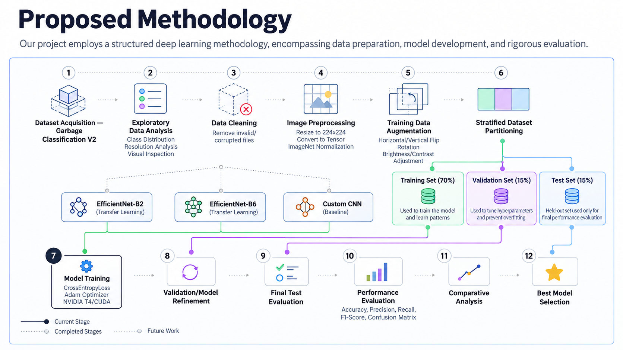
Figure: Proposed deep-learning methodology for garbage image classification.
5

Slide 6
Implementation Progress
The data preparation and model-development pipeline has been implemented, while experimental model training is currently in progress.
Dataset ✓ → EDA ✓ → Processing ✓ → Split ✓ → Models ✓ → TRAINING ◉ → Evaluation ○
✓ Completed ◉ Current Stage ○ Future Work
Completed Implementation
Current Experimental Setup
Dataset acquisition and EDA
Cleaning, preprocessing and augmentation
Stratified 70/15/15 partitioning
PyTorch DataLoaders and input verification
EfficientNet-B2, EfficientNet-B6 and Custom CNN implemented
CUDA/T4 training environment configured
Model Architectures
EfficientNet-B2 — Transfer Learning
EfficientNet-B6 — Transfer Learning
Custom CNN — Baseline
Training Configuration
Framework: PyTorch
Loss Function: CrossEntropyLoss
Optimizer: Adam
Learning Rate: 0.001
Batch Size: 16
Hardware: NVIDIA T4 GPU / CUDA
6

Slide 7
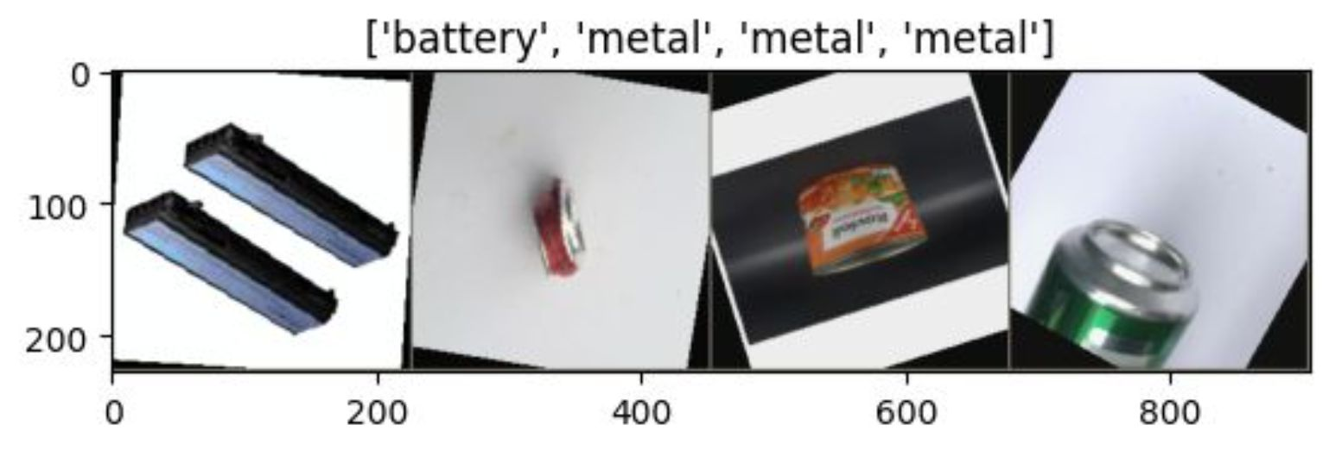
Preliminary Observations & Pipeline Verification
Dataset Insights
Class-distribution analysis completed across 10 garbage categories.
Original image resolutions and representative samples were analyzed during EDA.
All images are resized to 224 × 224 pixels during preprocessing
Pipeline Verification
PyTorch DataLoaders successfully generate training batches.
Training augmentation includes horizontal/vertical flips, rotation, and brightness/contrast adjustment.
Input batches follow the expected tensor shape: [16, 3, 224, 224] (batch, channels, height, width).
CUDA-enabled model training has been successfully initiated on an NVIDIA T4 GPU.
7
Notes:
This slide serves as our "Preliminary Results" section, focusing on verifiable outputs rather than speculative performance metrics.
We have thoroughly analyzed the dataset, ensuring its readiness for model training. This includes understanding the class distribution, inspecting image quality, and confirming standardization of all images.
Crucially, our data pipeline is robust: training batches load correctly, augmentation applies as expected, and tensor dimensions are verified. We've confirmed our CUDA environment is active and training has begun, which is key implementation evidence.
The image visually demonstrates our data preprocessing by showing a grid of original alongside augmented images, highlighting the transformation our data undergoes before feeding into the models.

Slide 8
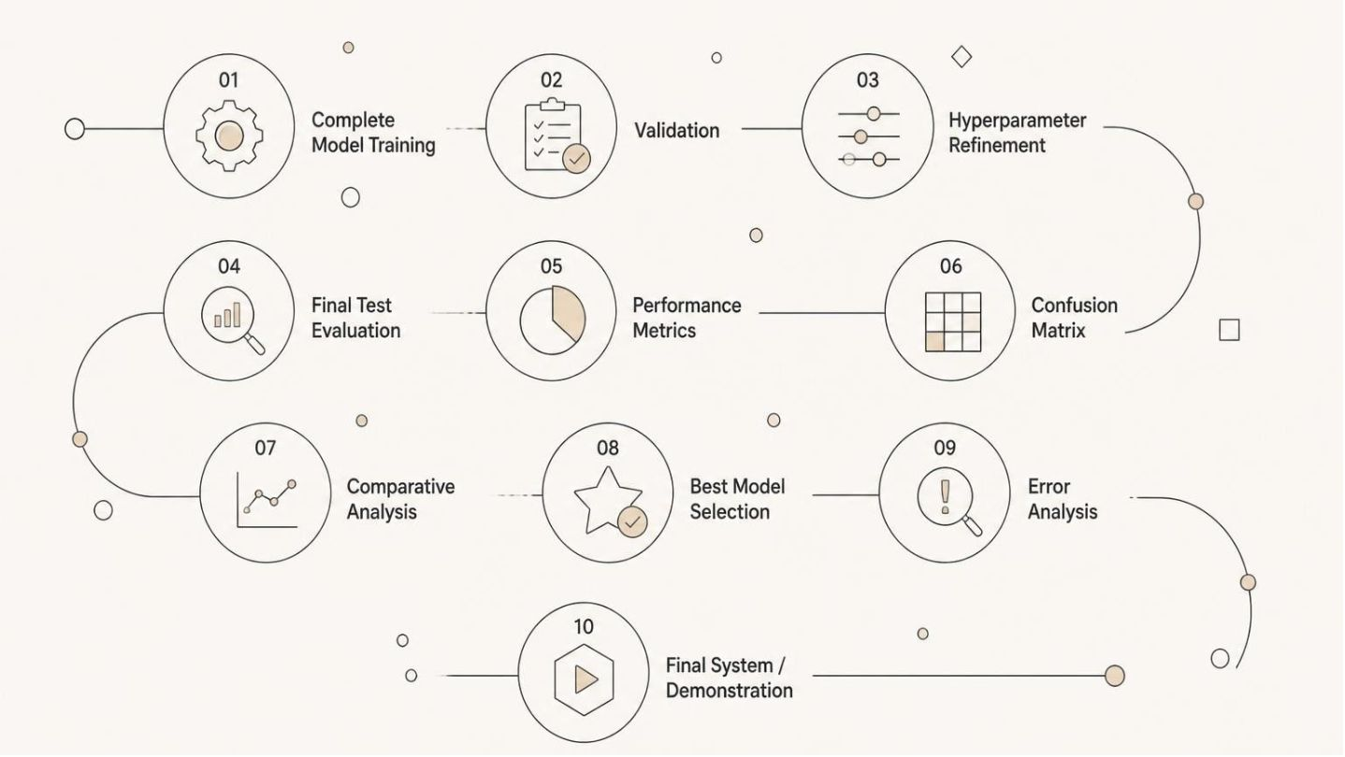

Next Steps & Remaining Work
With foundational work complete, our focus now shifts to the experimental phase and rigorous evaluation.
Planned Evaluation Metrics
To ensure a comprehensive assessment of model performance, we will utilize a suite of established metrics:
Accuracy
Precision
Recall
The overall percentage of correct classifications across all categories.
When the model predicts a particular category, how often that prediction is correct.
How effectively the model finds actual instances of a specific category.
F1-Score
Confusion Matrix
A harmonic mean that balances both precision and recall, useful for imbalanced datasets.
A table that visualizes the performance of an algorithm, showing which categories are being confused with each other.
8
Notes:
This slide outlines the remaining phases of our project. It clearly communicates to the audience what's left to do before completion.
I've used an infographic to visually represent the sequential flow of our pipeline, starting from completing model training all the way to a final system demonstration. This helps the audience quickly grasp the scope of work ahead.
Below the pipeline, I've detailed the specific evaluation metrics we will use. This is critical for an academic project, as it shows we have a clear plan for how to quantitatively assess our model's success. I will explain each metric briefly, emphasizing why it's important and how it contributes to a thorough understanding of our model's performance, especially highlighting the utility of the confusion matrix for error analysis.
It's important to convey that while these experiments haven't been completed yet, we have a well-defined strategy for their evaluation.

Slide 9
Conclusion
Our journey from raw data to a fully evaluated deep learning model is progressing systematically. This presentation concludes with a summary of our current achievements and a clear roadmap for the immediate future.
Current Status
Next Phase
Data preparation and preprocessing pipeline completed.
Candidate classification architectures implemented (EfficientNet-B2, B6, Custom CNN).
Experimental model training is currently underway.
Evaluation
Comparative analysis
Best-model selection
9
Notes:
This is the conclusion slide, serving as a concise summary of our project's standing and immediate next steps.
I will emphasize the solid foundation we've built, highlighting the completion of data preparation, preprocessing, and the implementation of our chosen model architectures. It's crucial to state that experimental training is actively ongoing.
For the next phase, I'll clearly outline the rigorous evaluation, comparative analysis, and ultimate selection of the best model, reinforcing our scientific approach.
I will deliberately avoid any premature claims about model success or accuracy, as these have not yet been empirically established. The accent image subtly conveys progress without implying a finished product.

Slide 10
References
[1] Garbage Classification V2, Kaggle. Dataset identifier: sumn2u/garbage-classification-v2.
[2] M. Tan and Q. V. Le, "EfficientNet: Rethinking Model Scaling for Convolutional Neural Networks," Proceedings of the 36th International Conference on Machine Learning (ICML), 2019.
[3] PyTorch and TorchVision Documentation, PyTorch Foundation.
10
Notes:
This slide clearly lists all the external information, datasets, methods, and architectures that form the foundation of our project. It demonstrates our commitment to academic integrity and provides transparency regarding our sources.
I typically won't verbally present this slide unless specifically asked to do so by the audience. However, it's crucial for the comprehensive report.
The note about handling citations on other slides (e.g., "Tan & Le (2019)" on the EfficientNet slide) reinforces proper academic practice throughout the presentation.

